Slide 1

Neural network
Justin Grosz

Slide 2
Today’s Agenda
Review Last Week’s Homework
Neural Networks
Discussion Around Neural Network Video
Python Neural Network
Week 5 Update

Slide 3

Decision Tree Hw

Slide 4
Neural Networks

Slide 5
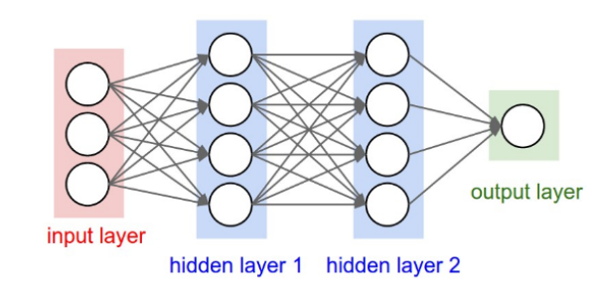
A Bit Of Math today
Neural Networks Are A Function Just Like Logistic & Linear Regression
Remember A GLM Must Have A Linking Function -> Neural Network The Same
Broken Into …..
Neuron -> Pass Input Values
Weights -> Additive Value In Motion
Neurons Are Then Connected By…
Layers

Slide 6
Terminology
Weights
Neurons

Slide 7
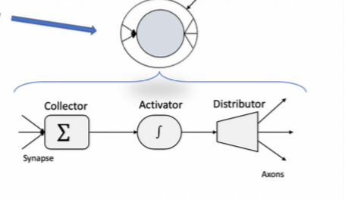
Neurons
Within The Neurons There Are Actually Three Layers, Before It Hits The Connector
Collector -> Gathers Calculations From Previous Layers
Activator -> Function (Coming In Upcoming Slides)
Distributor -> Pass Through To Next Layer

Slide 8
Understanding The Function(s) Behind Neural network
There Is Not One Function That A Neural Network Could Be Composed Of
Sigmoid -> Most Common
TanH
ReLU -> Very Popular In Deep Learning

Slide 9
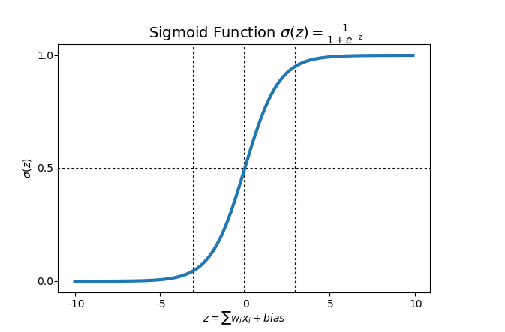
Sigmoid
Looks Very Similar To Logistic Regression (it is)
Similar Curvature
0 – 1
Introduces That Neural Network Isn’t Linear
Diminishing Gradient Problem
Squeezed Range of Derivative between 0 and 1
We Will See This Is A Big Downfall Compared To Others

Slide 10
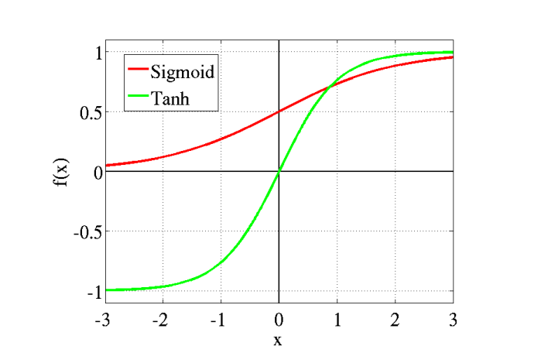
tanh
Similar Curvature To Sigmoid….
Look At The Y-Axis
Better Than Sigmoid If Inputs Are Negative
Latitude & Longitude
Temperature

Slide 11
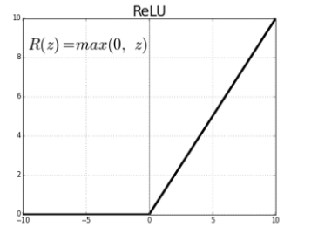
ReLu
Step Function
Weighing Pros & Cons
Pros
Function Calculates Fastest & One Reason For Popularity
No diminishing gradient
Con
Too Many Inputs Are Zero -> Maps To 0

Slide 12
Tesla video discussion

Slide 13
Neural network code

Slide 14
Loading data
import matplotlib.pyplot as plt
import numpy as np
import pandas as pd
from sklearn import datasets
from sklearn.model_selection import train_test_split
from sklearn.model_selection import cross_val_score
import statsmodels.api as sm
from scipy import stats
import seaborn as sns
from sklearn.preprocessing import LabelEncoder
iris=datasets.load_iris() #Looking at house prices in Boston
df = pd.DataFrame(np.c_[iris['data'], iris['target']],
columns= np.append(iris['feature_names'], ['target’]))
sns.pairplot(df,hue="target", size=3, diag_kind="kde")

Slide 15
Build Initial Model
x=df.iloc[:, list(range(4))]
y = df['target']
x_train, x_test, y_train, y_test = train_test_split(x, y, test_size = 0.20)
labelencoder = LabelEncoder()
df["target"] = labelencoder.fit_transform(df["target"])
species = pd.DataFrame({'target': ['Iris-setosa', 'Iris-versicolor', 'Iris-virginica']})

Slide 16
Build Initial Model
def create_dummies(df,column_name):
dummies = pd.get_dummies(df[column_name],prefix=column_name)
df = pd.concat([df,dummies],axis=1)
return df
data = create_dummies(df,"target")

Slide 17
Build Initial Model
# Features before mean normalization
unscaled_features = x_train
from sklearn.preprocessing import StandardScaler
sc = StandardScaler()
x_train_array = sc.fit_transform(x_train.values)
# Assign the scaled data to a DataFrame & use the index and columns arguments to keep your original indices and column names:
x_train = pd.DataFrame(x_train_array, index=x_train.index, columns=x_train.columns)
x_test_array = sc.transform(x_test.values)
x_test = pd.DataFrame(x_test_array, index=x_test.index, columns=x_test.columns)

Slide 18
Build Initial Model
from sklearn.neural_network import MLPClassifier
# Initializing the multilayer perceptron
mlp = MLPClassifier(3,solver='sgd',learning_rate_init= 0.01, max_iter=100)
mlp.fit(x_train, y_train)
mlp.score(x_test,y_test)

Slide 19
Gradient boosting
from sklearn.ensemble import GradientBoostingClassifier
gbclass=GradientBoostingClassifier(random_state=0)
gbclass.fit(x_train,y_train)
gbypred=gbclass.predict(x_test)
gbclass.score(x_test, y_test)
Difference??

